Slide 1
Getting Started with the Latest ML Approaches: From Research Papers to Running State-of-the-Art Code Demo: Training an EEG-to-fMRI Translator
BrainHack Vanderbilt 2025
Yamin Li, Ph.D. student
Neurdy Lab, Vanderbilt University
Notes:
Some materials: https://www.youtube.com/watch?v=nakAMbKnzx4 – Foundation models in neuroscience
https://www.youtube.com/watch?v=Eem-OxkvTCc – Brain decoding tutorial

Slide 2
What you will learn:
Where to find cutting-edge DL/ML research papers.
Finding and utilizing the right resources.
How to get started with the repo and run inference/train these models
Hands on! Run state-of-the-art code demo together

Slide 3
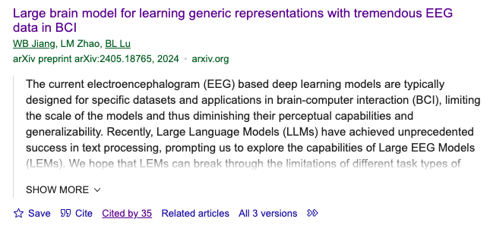
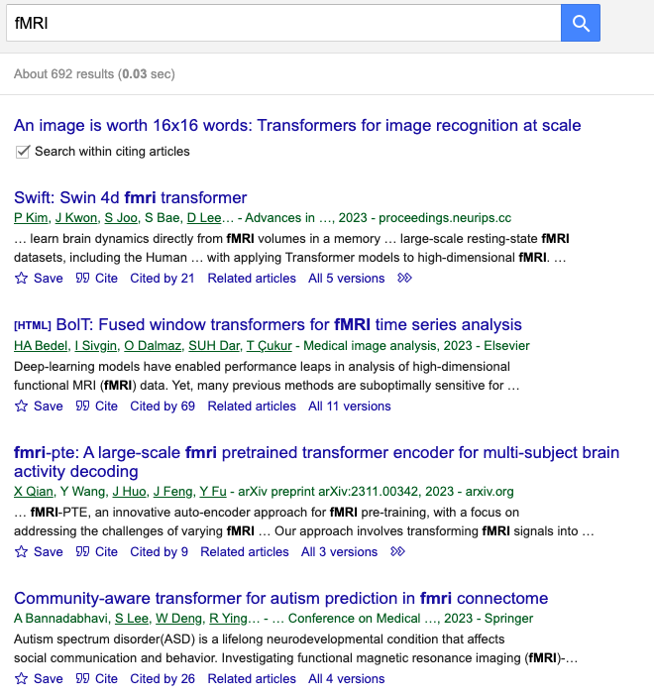
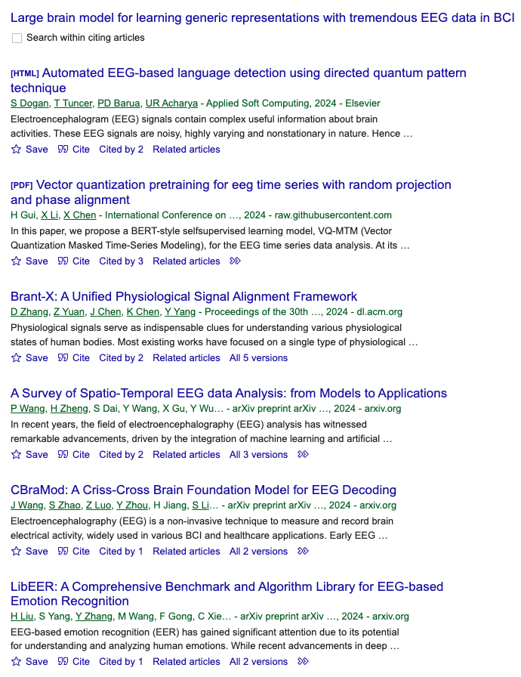
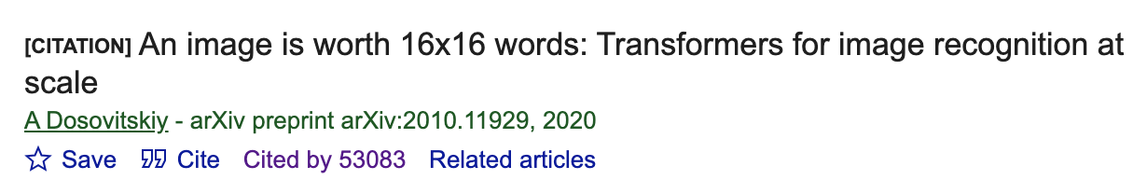









Step 1 - Finding the Right paper
Use Popular Platforms:
Google Scholar
arXiv.org , bioRxiv.org
Top DL/ML Conference Proceedings (NeurIPS, CVPR, ICLR, ICML, MICCAI…)
OpenReview
Follow Citation Trails:
Find related works by checking the references and citations.
Leverage Social Platforms:
Follow researchers on Twitter, LinkedIn, and GitHub.

Slide 4
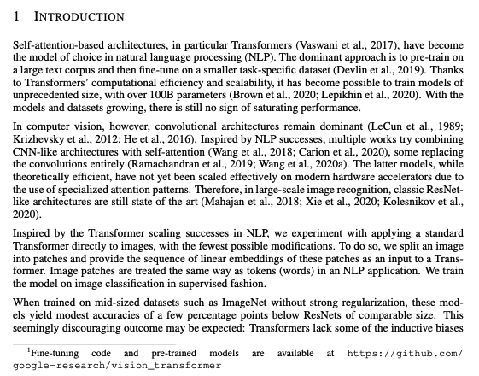

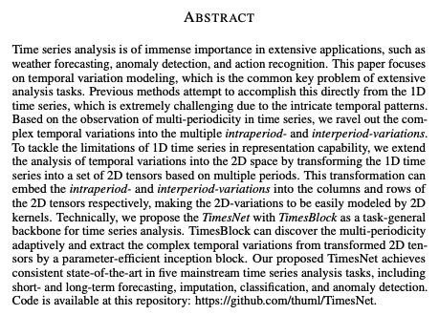

Step 2 - Finding Resources
Platforms to Access Code & Datasets:
- Usually can be found in footnote, ‘Abstract’, ‘Reproducibility statement’, ‘Experiments’
GitHub (https://github.com/):
Search ‘github’ or ‘code’ to find links in paper
Search repositories by paper title or keywords in google.
Project Pages:
Many papers have a dedicated project page with official links to code and datasets.
Datasets:
Search keyword ‘dataset’ in paper/repo
Often hosted on platforms like Hugging Face or other shared links.
Model checkpoints/pre-trained weights:
Search keyword ‘dataset’, ‘checkpoint’, ‘weights’, ‘pretrained’ in paper/repo
Often hosted on platforms like Hugging Face or other shared links.

Slide 5
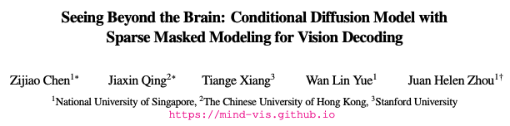
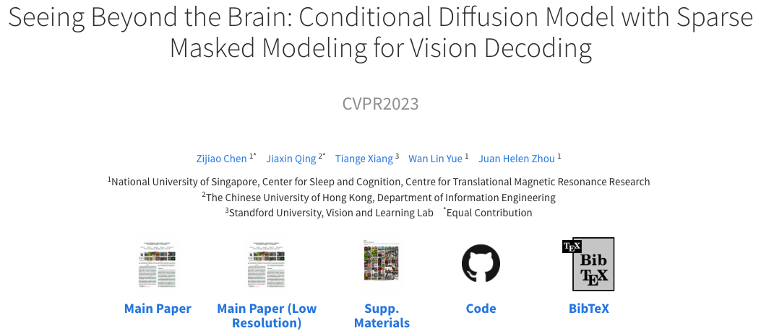
Step 2 - Finding Resources
Platforms to Access Code & Datasets:
- Usually can be found in footnote, ‘Abstract’, ‘Reproducibility statement’, ‘Experiments’
GitHub (https://github.com/):
Search ‘github’ or ‘code’ to find links in paper
Search repositories by paper title or keywords in google.
Project Pages:
Many papers have a dedicated project page with official links to code and datasets.
Datasets:
Search keyword ‘dataset’ in paper/repo
Often hosted on platforms like Hugging Face or other shared links.
Model checkpoints/pre-trained weights:
Search keyword ‘dataset’, ‘checkpoint’, ‘weights’, ‘pretrained’ in paper/repo
Often hosted on platforms like Hugging Face or other shared links.

Slide 6
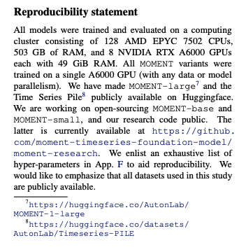
Step 2 - Finding Resources
Platforms to Access Code & Datasets:
- Usually can be found in footnote, ‘Abstract’, ‘Reproducibility statement’, ‘Experiments’
GitHub (https://github.com/):
Search ‘github’ or ‘code’ to find links in paper
Search repositories by paper title or keywords in google.
Project Pages:
Many papers have a dedicated project page with official links to code and datasets.
Datasets:
Search keyword ‘dataset’ in paper/repo
Often hosted on platforms like Hugging Face or other shared links.
Model checkpoints/pre-trained weights:
Search keyword ‘dataset’, ‘checkpoint’, ‘weights’, ‘pretrained’ in paper/repo
Often hosted on platforms like Hugging Face or other shared links.
Model weights
Datasets
Pretrained weights are the learned parameters of a deep learning model that have been trained on a (large) dataset and can be used to initialize a model for fine-tuning or inference.

Slide 7
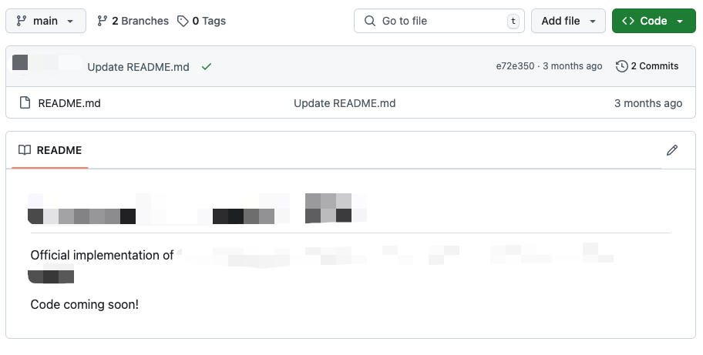

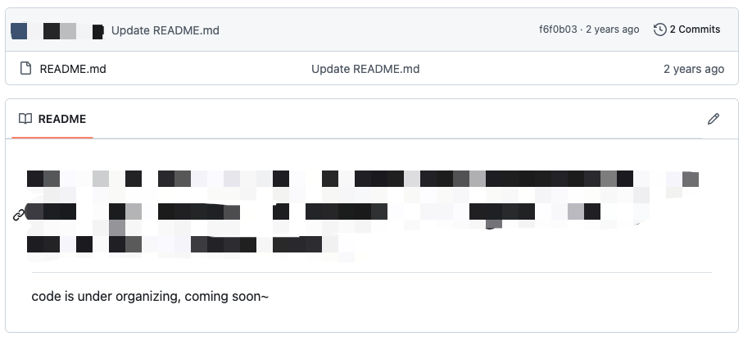
Types of Github repo you may find:
Type 2: Messy repos
Type 1: “Coming soon” repos

Slide 8
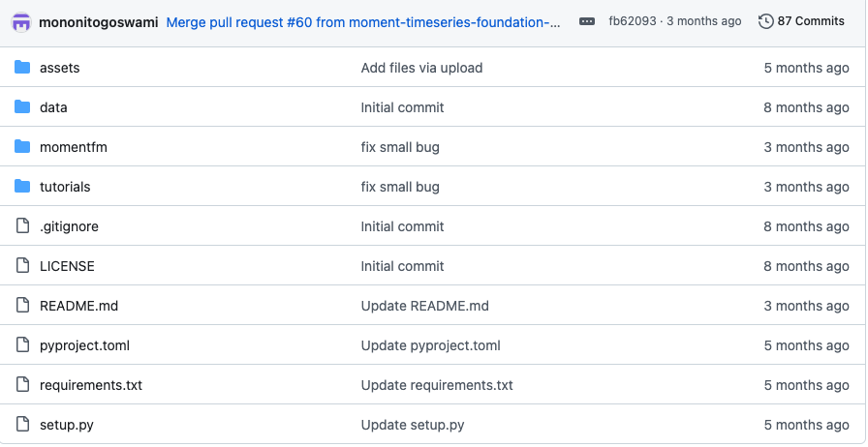
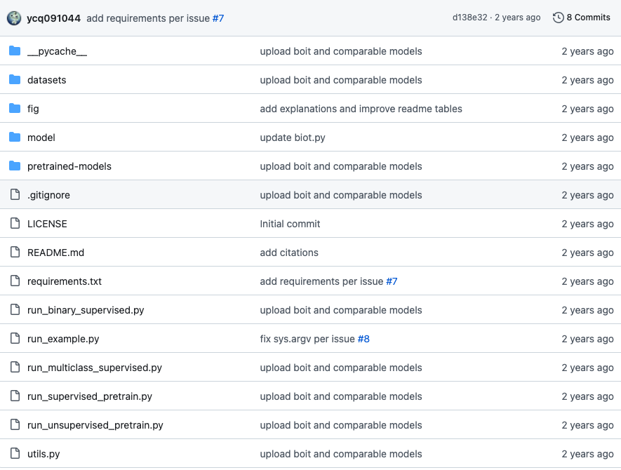
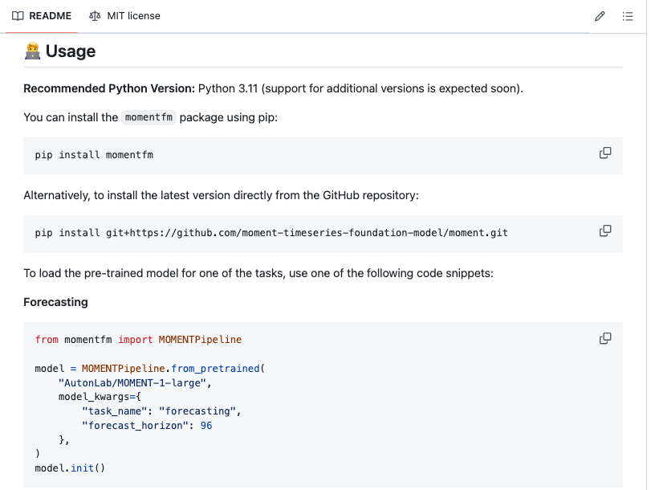
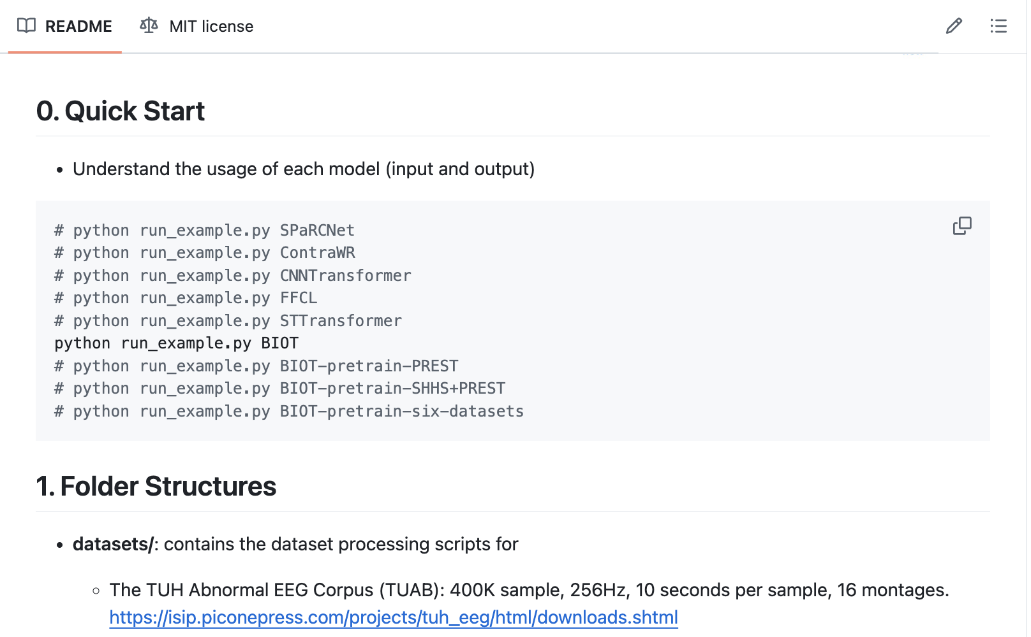
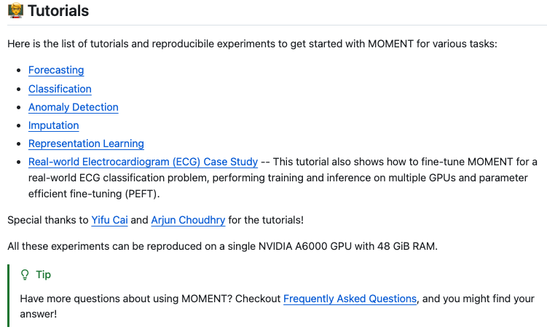
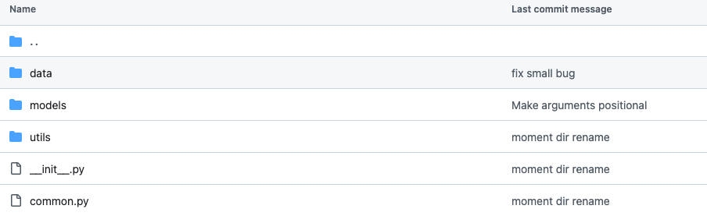
Types of Github repo you may find:
Type 3: Clean and clear repos
https://github.com/ycq091044/BIOT
https://github.com/moment-timeseries-foundation-model/moment/tree/main

Slide 9
Step3. Things to check before running

Slide 10
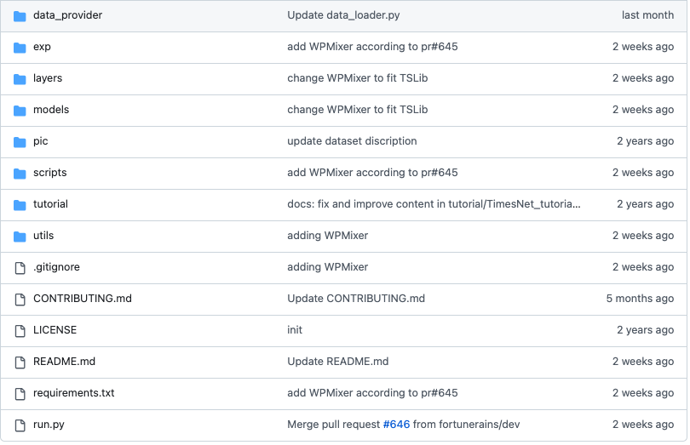
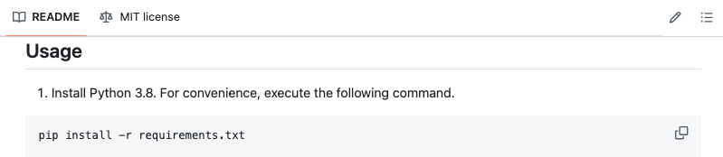
Step3. Things to check before running
Environment Mismatch: (also show examples)
Install requirements.txt or environment.yaml into your virtual environment.
Ensure the correct Python version and dependencies are installed.
https://github.com/thuml/Time-Series-Library

Slide 11
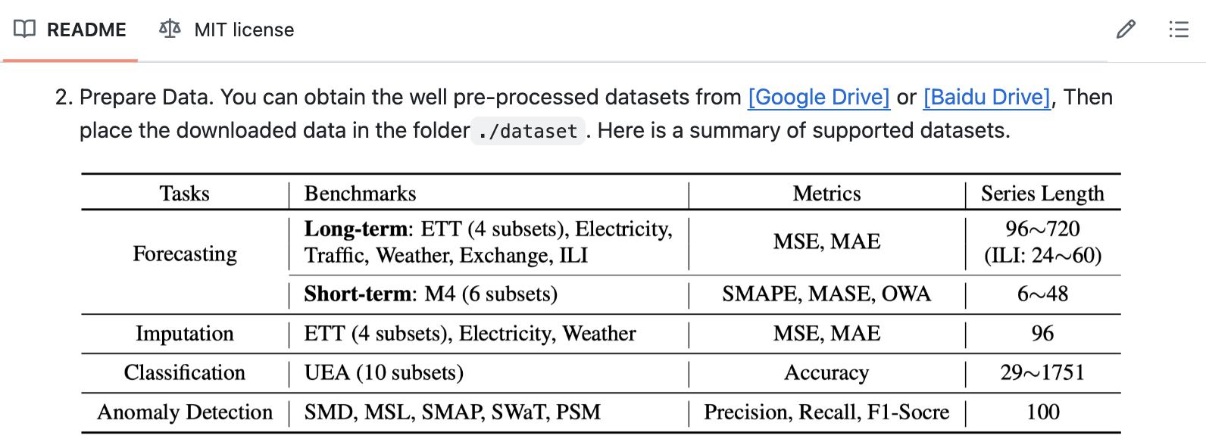
Step3. Things to check before running
Environment Mismatch: (also show examples)
Install requirements.txt or environment.yaml into your virtual environment.
Ensure the correct Python version and dependencies are installed.
Data Format:
Usually sample data included
(if using your own data) Verify input data formats match the repository’s requirements.
Preprocess your data as per instructions in the documentation (search for ‘preprocessing’ keyword in paper/repo)
https://github.com/thuml/Time-Series-Library

Slide 12
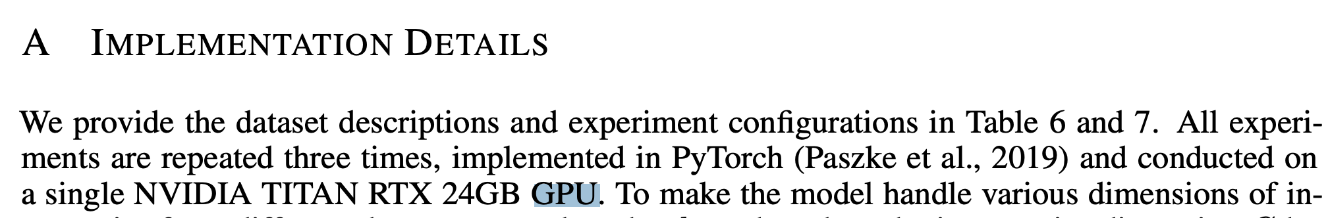
Step3. Things to check before running
Environment Mismatch: (also show examples)
Install requirements.txt or environment.yaml into your virtual environment.
Ensure the correct Python version and dependencies are installed.
Data Format:
Usually sample data included
(if using your own data) Verify input data formats match the repository’s requirements.
Preprocess your data as per instructions in the documentation (search for ‘preprocessing’ keyword in paper/repo)
Hardware Requirements:
Some repositories require GPUs with high memory (e.g., 16 GB+) (GPU info can usually be found in ‘Implementation Details’, ‘Reproducibility statement’ in paper).
The hardware mentioned in the paper may not necessarily indicate the minimum requirements for training the model, unless explicitly stated as "required.”
Inference usually requires significantly lower GPU resources compared to training.
Check if multi-GPU or distributed training is supported.

Slide 13
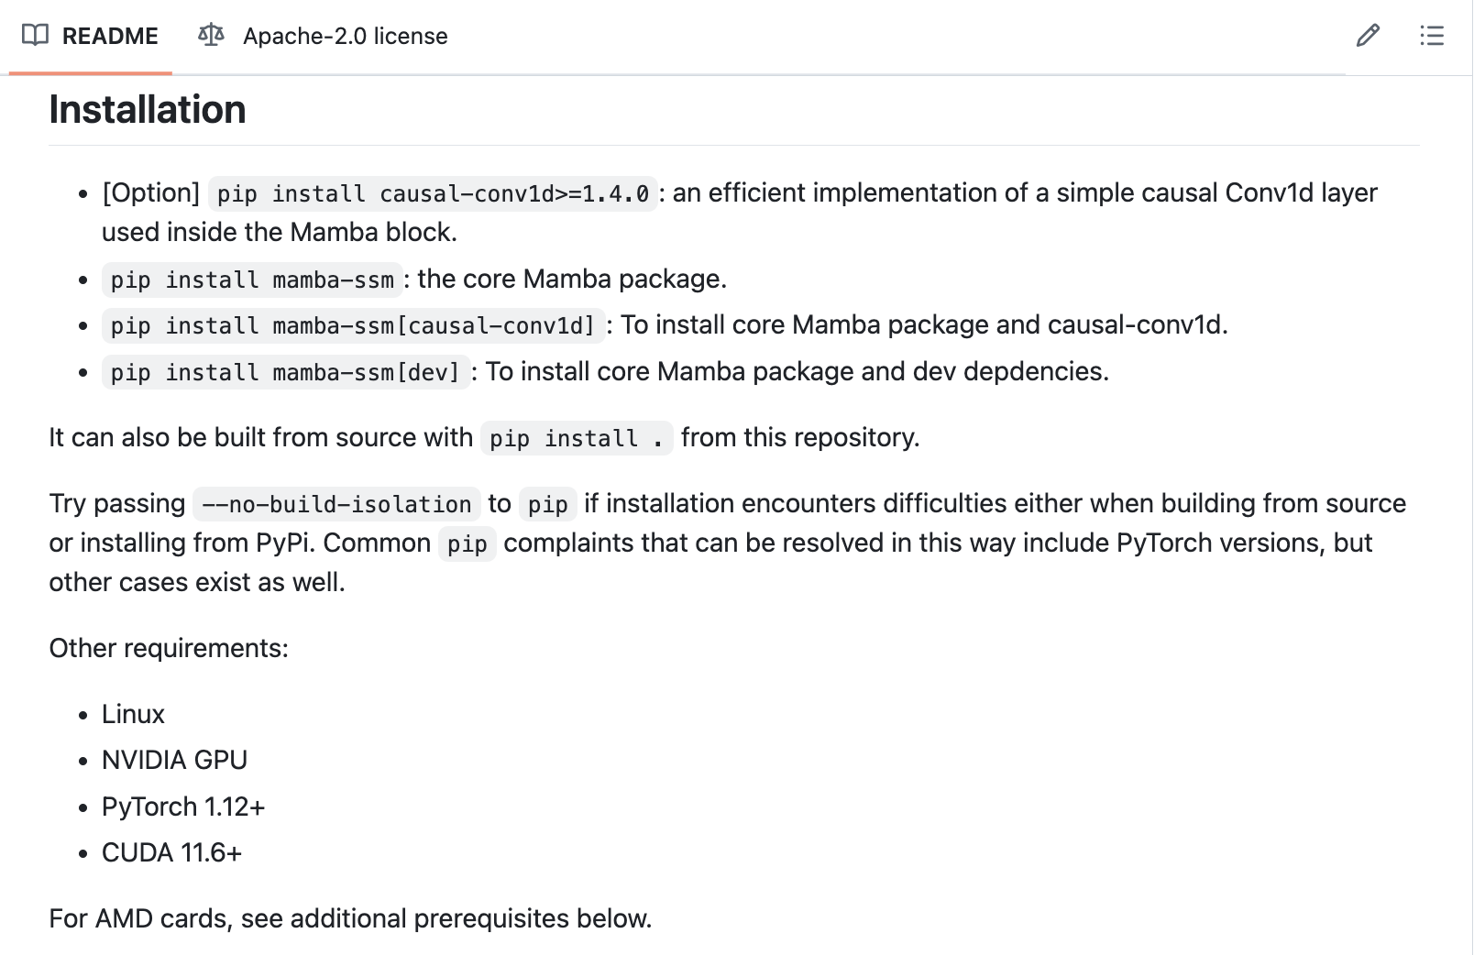
Step3. Things to check before running
Environment Mismatch: (also show examples)
Install requirements.txt or environment.yaml into your virtual environment.
Ensure the correct Python version and dependencies are installed.
Data Format:
Usually sample data included
(if using your own data) Verify input data formats match the repository’s requirements.
Preprocess your data as per instructions in the documentation (search for ‘preprocessing’ keyword in paper/repo)
Hardware Requirements:
Some repositories require GPUs with high memory (e.g., 16 GB+) (GPU info can usually be found in ‘Implementation Details’, ‘Reproducibility statement’ in paper).
The hardware mentioned in the paper may not necessarily indicate the minimum requirements for training the model, unless explicitly stated as "required.”
Inference usually requires significantly lower GPU resources compared to training.
Check if multi-GPU or distributed training is supported.
Code Compatibility:
Check for compatibility with your OS (Linux, macOS, Windows).
https://github.com/state-spaces/mamba

Slide 14
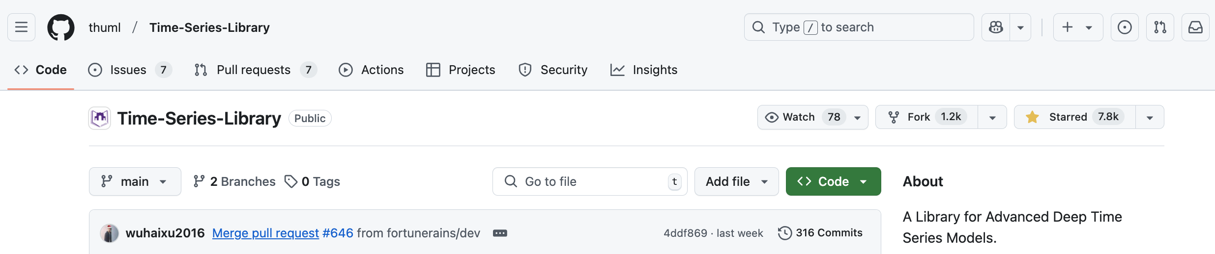
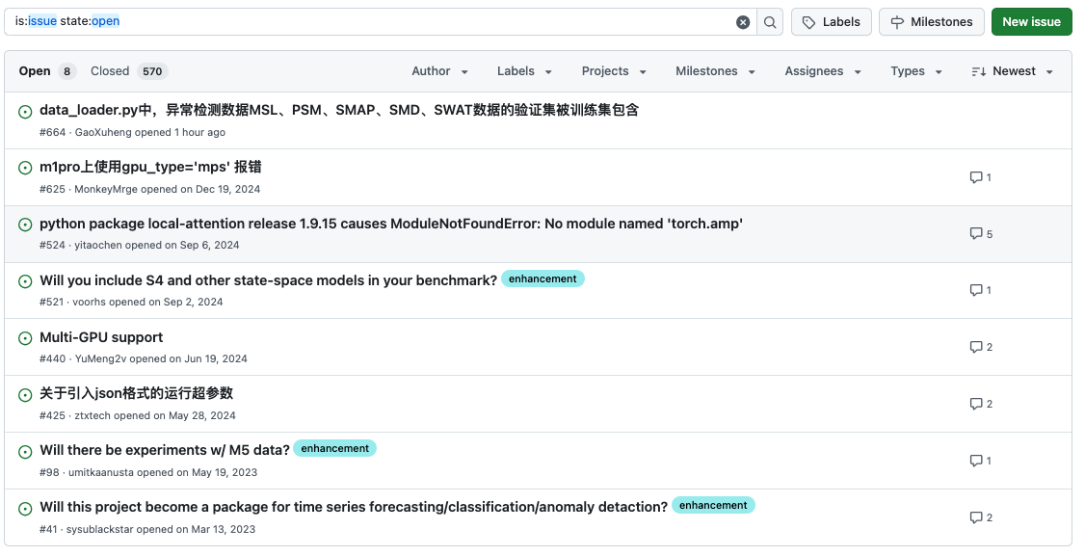
Step3. Things to check before running
Environment Mismatch: (also show examples)
Install requirements.txt or environment.yaml into your virtual environment.
Ensure the correct Python version and dependencies are installed.
Data Format:
Usually sample data included
(if using your own data) Verify input data formats match the repository’s requirements.
Preprocess your data as per instructions in the documentation (search for ‘preprocessing’ keyword in paper/repo)
Hardware Requirements:
Some repositories require GPUs with high memory (e.g., 16 GB+) (GPU info can usually be found in ‘Implementation Details’, ‘Reproducibility statement’ in paper).
The hardware mentioned in the paper may not necessarily indicate the minimum requirements for training the model, unless explicitly stated as "required.”
Inference usually requires significantly lower GPU resources compared to training.
Check if multi-GPU or distributed training is supported.
Code Compatibility:
Check for compatibility with your OS (Linux, macOS, Windows).
GitHub repo Issues is your friend:
Browse the repository's issues section for known problems or updates.
https://github.com/thuml/Time-Series-Library

Slide 15

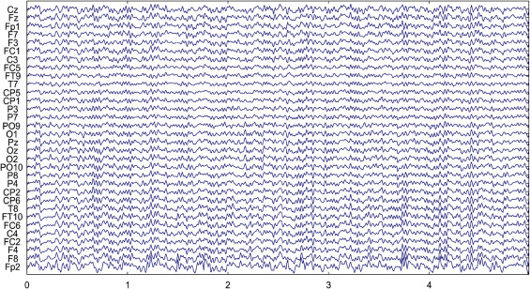
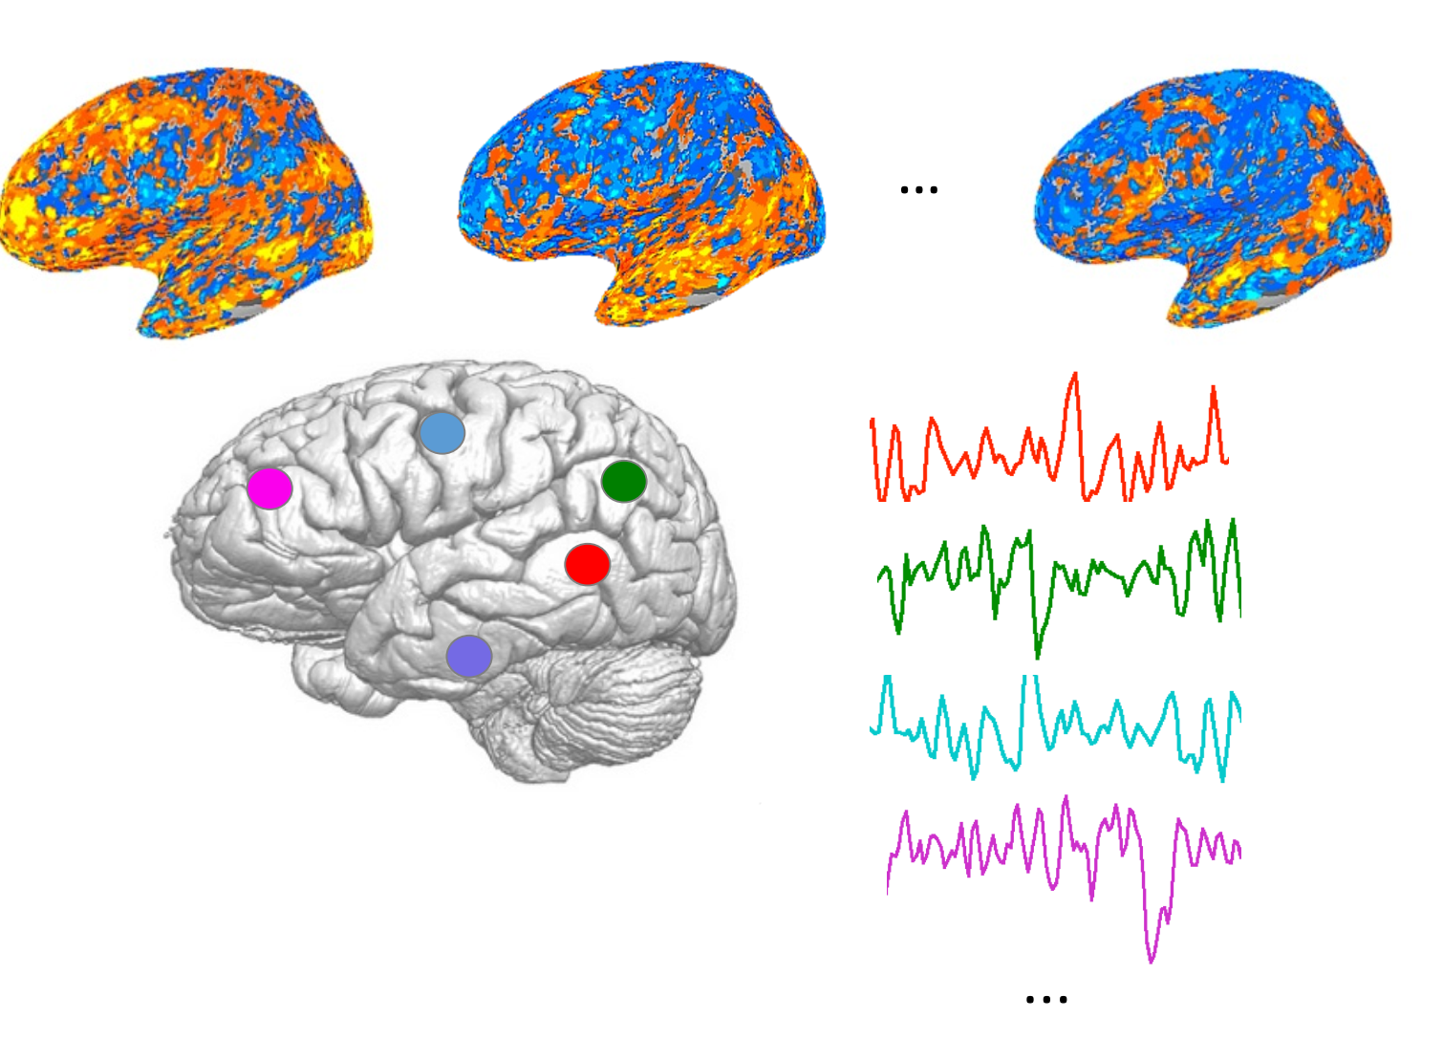
Hands-on Quick start with the DL repo
Let’s do it!
In this demo, we will together run inference on a novel DL model – NeuroBOLT (Neuro-to-BOLD Transformer).
NeuroBOLT can translate EEG signals into corresponding fMRI ROI time series.
NeuroBOLT supports:
Any configuration of EEG electrodes as input when training from scratch
Any subset of the originally used EEG electrodes when performing inference with a pre-trained model.
Demo file name: NeuroBOLT-inference-demo.ipynb
Electroencephalogram (EEG)
Functional Magnetic resonance imaging (fMRI)
NeuroBOLT
Channel
Time
Li et al., “NeuroBOLT: Resting-state EEG-to-fMRI Synthesis with Multi-dimensional Feature Mapping”, NeurIPS 2024

Slide 16
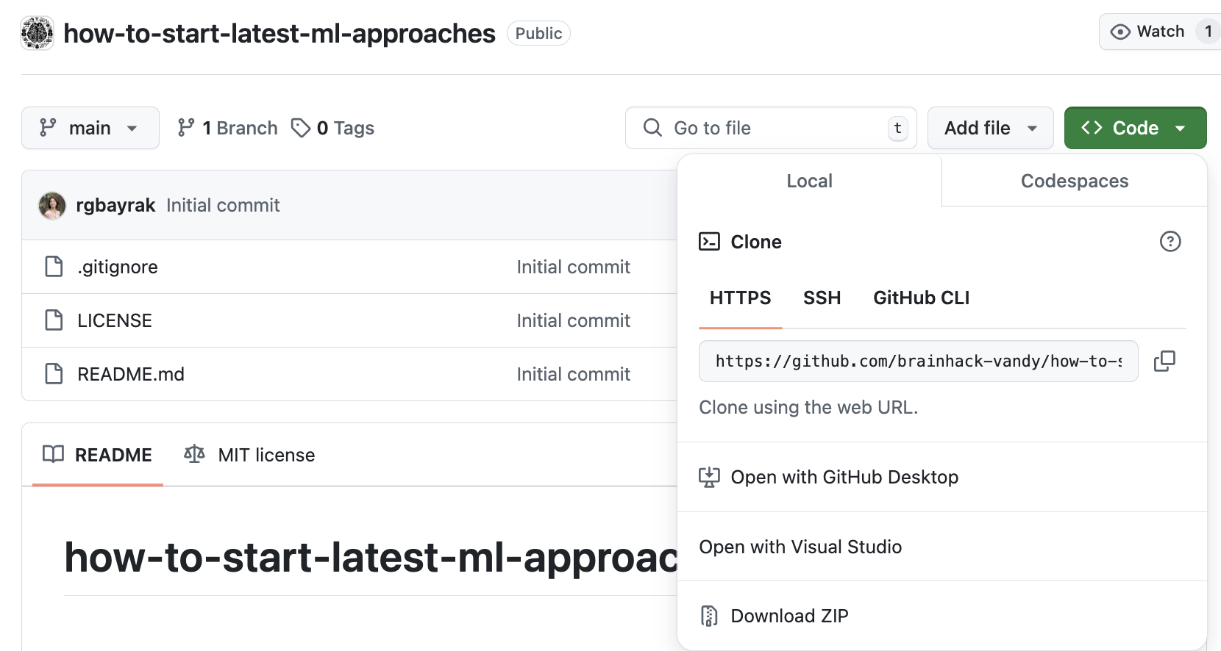
Step4. Quick start with the DL repo
Assuming you found your favorite repo and it has a great README and usable code, what’s next?
Download repo & resources and get prepared (See README.md file on the repo)
Git clone
git clone https://github.com/brainhack-vandy/how-to-start-latest-ml-approaches.git
Install virtual environment and all dependencies
Download Dataset/model weights
Open demo/tutorial notebook
Google Colab
https://colab.research.google.com/drive/1ZfTZU6E2wVoS2NuIDHpVaZGxRjxptIz_?usp=sharing

Slide 17
Step4. Quick start with the DL repo
Assuming you found your favorite repo and it has a great README and usable code, what’s next?
Get familiar with the repo
Understand the repository structure.
Find the main scripts for model training and inference.
Test with examples before customization.
How to quickly test the model?
Send random data in!
Common files and folders
README.md: Overview, usage, and examples.
main.py or run.py: Main script for running the experiment.
model.py or src/: Model architecture definition.
train/engine.py: Script/functions for training the model.
data/:Scripts for preprocessing data/dataloaders
utils/: Folder for storing the useful functions.
inference.py or predict.py: For running inference.
config.yaml or similar: Hyperparameter settings.
requirements.txt or environment.yml: Dependencies.
…

Slide 18
Step4. Quick start with the DL repo
Generate a random tensor that matches the input shape required by the model
# Sample time series/ features data (batch_size, n_channels, sample_length)
x = torch.randn(64, 16, 2000)
# Sample image data (batch_size, n_channels(R,G,B), height, width)
x = torch.randn(64, 3, 224, 224)
Initialize the model and pass the generated tensor as input.
model = CoolModel(emb_size=256, heads=8, depth=4, n_classes=5,
n_fft=200, hop_length=100)
out = model(x)
# or out1, out2 = model(x) # some model might have multiple outputs
print(out.shape)
Set breakpoints in the code to observe how the model processes features

Slide 19
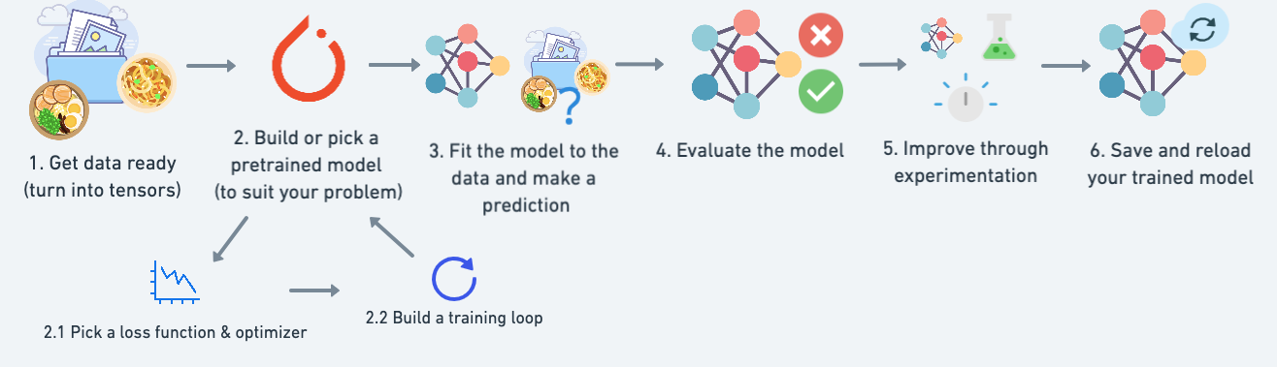
Deep learning: generic workflow
1.1 Processing your data, standardize, optionally augment

Slide 20
Deep learning: inference workflow
(pass new data to a pretrained model)
1.1 Processing your data, standardize, optionally augment
with torch.no_grad():
model.eval()
y_hat = model(x)
model.load_state_dict(torch.load('model_weights.pth'))
Inference is the process of using a trained model to make predictions or generate outputs based on new, unseen data
Pretrained weights are the learned parameters of a deep learning model that have been trained on a large dataset and can be used to initialize a new model for fine-tuning or inference.

Slide 21
Deep learning: finetune/train workflow
1.1 Processing your data, standardize, optionally augment
model.load_state_dict(torch.load('model_weights.pth'))
(If task is different, consider changing a loss)
Fine-tuning is the process of taking a pre-trained machine learning model and further training it on a specific task or dataset to improve its performance and adapt it to specialized requirements.

Slide 22
Takeaway Tips
Documentation First: Always read the README.md and installation guides.
Start Small: Run examples or demo scripts before training the full model.
Seek Help: Check Issues on GitHub or contact the authors for clarification.
Stay Updated: Subscribe to arXiv alerts/author’s social media for updates on related research or new publications.

Slide 23





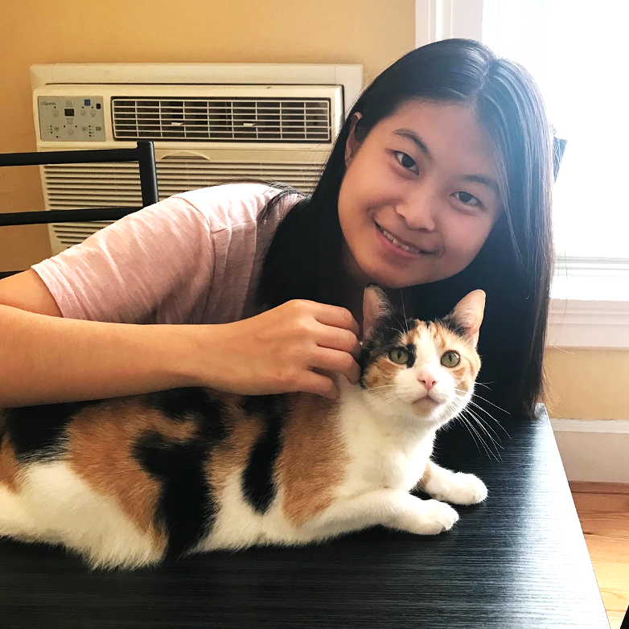










Acknowledgement
NeuroBOLT team
Yamin Li
Ange Lou
Ziyuan Xu
Shengchao Zhang
Shiyu Wang
Dario J. Englot
Soheil Kolouri
Daniel Moyer
Roza G. Bayrak
Catie Chang

Slide 24
Thank you!!

